Slide 1
Financial Exchanges and High-Frequency Trading

Slide 2
Today’s Lecture
Background on financial exchanges
  The role of financial exchanges
  Desirable attributes of an exchange
History of these markets
  Specialist markets, OTC markets, exchanges
  The move to electronic exchanges
High-Frequency trading and market design
  Speed race (Budish et al., Lewis)
  Market design for electronic exchanges

Slide 3
Public Equity Markets
Role of public equities markets
  Allocate capital efficiently. Provide liquidity for owners of companies. Create information that is useful to guide decisions.
Objectives for the public equities market
  Price discovery (prices reflect current information)
  Fair competition (open access, nondiscrimination)
  Investor protection and confidence
US government regulates financial markets to achieve these objectives, looking at things such as
  How fast are orders executed? How large are spreads? How large is systemic risk (risk of a complete market shut-down)? Are some investors being disadvantaged? Is there cheating or fraud?

Slide 4
Desirable market properties
Liquidity
  In liquid markets, traders can buy or sell large quantities of shares without a large price impact.
Transparency
  Participants have information available to them before making a trade (receive a quote, see open offers) and after a trade (see prices, quantities).
Price discovery
  Prices incorporate and track available information in the market - and do so in a reasonable and efficient way.

Slide 5
Organization of Markets
Historically, equities in US were mainly traded on the floor of the NYSE.
NYSE as a “specialist” market
  Each stock managed by a specialist
  Specialist quotes “bid” and “ask” prices
  Investors, who are physically on the trading floor, trade with the specialist at these prices
  Specialist holds some stock to keep market functioning, but not very large positions.

Slide 6
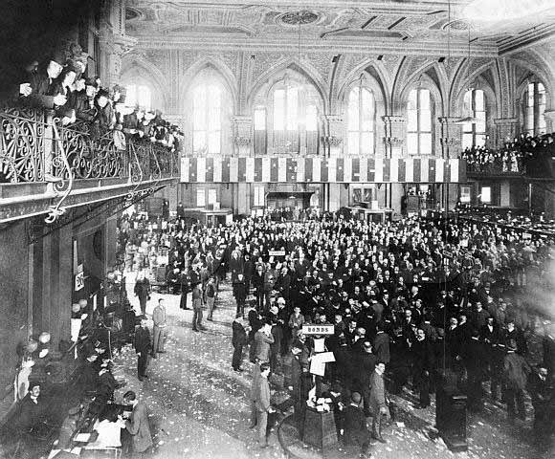
NYSE in 1903

Slide 7
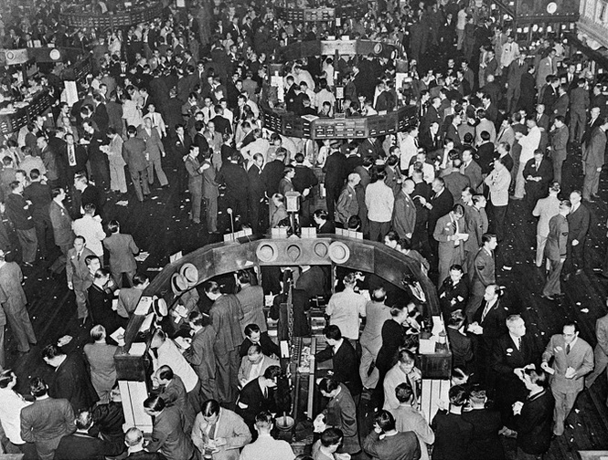
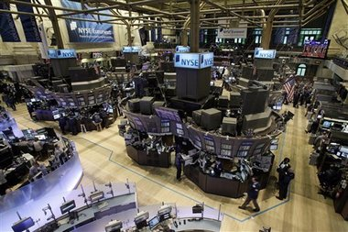
NYSE in 1929 and 2009

Slide 8
Organization of Markets
Nasdaq competed with NYSE and was historically an “over the counter” market.
Organization of OTC markets
  Small number of “brokers” quote bids/ask to prospective traders, who can trade with any of the brokers.
  In some OTC markets, executed trades are posted publicly creating a degree of transparency.
  OTC organization is typical for less “liquid” securities: corporate and municipal bonds, derivatives, etc.

Slide 9
Organization of markets
Equity trading has moved to electronic order books, including at NYSE.
Organization of electronic exchanges
  Traders submit orders to buy or sell
  Orders are posted in an electronic “book”
  If a buy order comes in above a current sell order, the orders are “crossed” and a trade is executed.
  Different exchanges allow different types of orders.
  Nowadays, many exchanges – at least a dozen – are public markets and many more “dark” exchanges.

Slide 10
Organization of markets
Large trades often are handled in different ways to avoid “price impact” if market is thin.
Organization of large trades
  Historically, large trades took place “upstairs” - not on the NYSE floor, by matching a large seller and buy it, or e.g. by having bank buy a position and slowly sell it.
  Nowadays, electronic exchanges are trying to automate large trades in a variety of different ways – dark pools, private “unlit” markets for larger orders.
  Large traders also can break up orders into smaller ones.

Slide 11
Faster, decentralized markets
Location of trades
  In Jan 2005: NYSE accounted for 80% of trading volume in NYSE-listed stocks; by Oct 2009, down to 25%
Execution speeds for trades
  Falls from 10.1 seconds in 2005, to 0.7 seconds in 2009.
Trading volume
  From 2.1 bn shares/day in 2005 to 5.9 bn in 2009.
Average trade size
  Falls from 724 shares in 2005 to 268 shares in 2009

Slide 12
Electronic Exchanges
Organized as continuous limit order books.
Limit order
  “Buy 100 Shares of IBM at $200.00
  “Sell 75 Shares of IBM at $201.14
Existing orders at any point in time form the “order book”
Orders can be added and withdrawn at any point.
If an order comes in that “crosses” the book, trade occurs.
  Existing buy orders for IBM: 100 shares at $200.00, 100 shares at $199.99, 100 shares at $199.98.
  If an order comes in to sell 250 shares of IBM at $199.97, will sell 100 shares at $200.00, 100 shares at $199.99, and 50 shares at $199.98.

Slide 13
Example: Order Book
Price
$200.03
$200.02
Existing Sell Orders (“Asks”)
$200.01
Bid-Ask Spread
$200.00
$199.99
Existing Buy Orders (“Bids”)
$199.98
$199.97
100
200
300
400
Quantity

Slide 14
Example: Order Book
Price
$200.03
$200.02
$200.01
$200.00
New Sell Order
$199.99
$199.98
$199.97
100
200
300
400
Quantity

Slide 15
Example: Order Book
Price
$200.03
$200.02
$200.01
$200.00
Order Book after the trade
Liquidity has been “taken” out.
$199.99
$199.98
$199.97
100
200
300
400
Quantity

Slide 16
High Frequency Trading
Shift to electronic trading and fragmented exchanges has created an opportunity for traders who
  Create liquidity by posting bid/ask offers in order books
  Trade quickly on market news to adjust asset prices
  Arbitrage price differentials between exchanges and securities
Generally, think of these functions as enhancing the price discovery, liquidity and competitiveness of equity markets.
But currently a lot of concerns as to whether HFT is working to the benefit of “regular” investors. (cf Michael Lewis book).

Slide 17
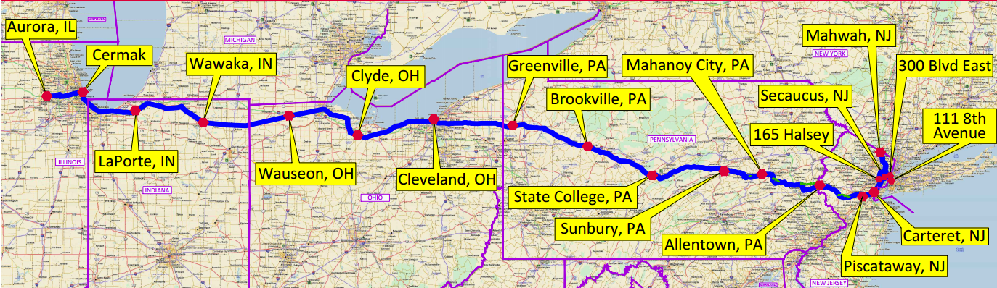
Spread Networks
In 2010, Spread networks constructed a high-speed fiber cable between New York and Chicago. Construction cost $300 million.
The cable reduced round-trip communication time from 16 milliseconds … to 13 milliseconds.
Spread charged about $20m to firms using the cable.

Slide 18
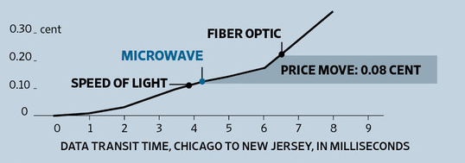
Race for Speed
How could 3 milliseconds make a difference?
Market participants felt it was imperative: “anyone pinging both markets has to be on this line, or they’re dead”.
Within three years, microwave transmission cut round-trip times further …. to 10, then 9, then 8.5 ms.
“Any HFT firm that has any ambitions whatsoever has already made a microwave play.” WSJ, May 30, 2012.

Slide 19
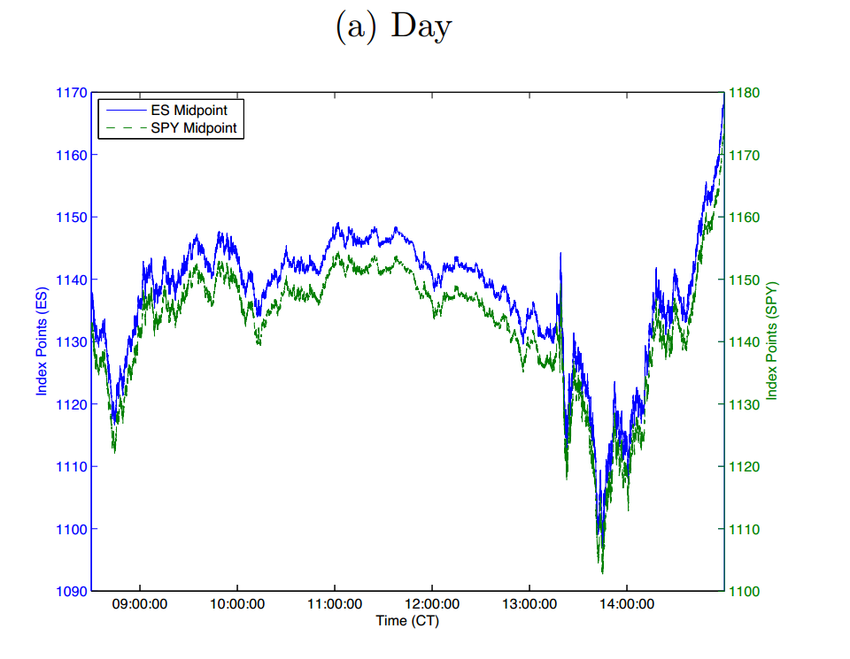
ES-SPY Trade
Source: Budish, Cramton and Shim (2013)

Slide 20
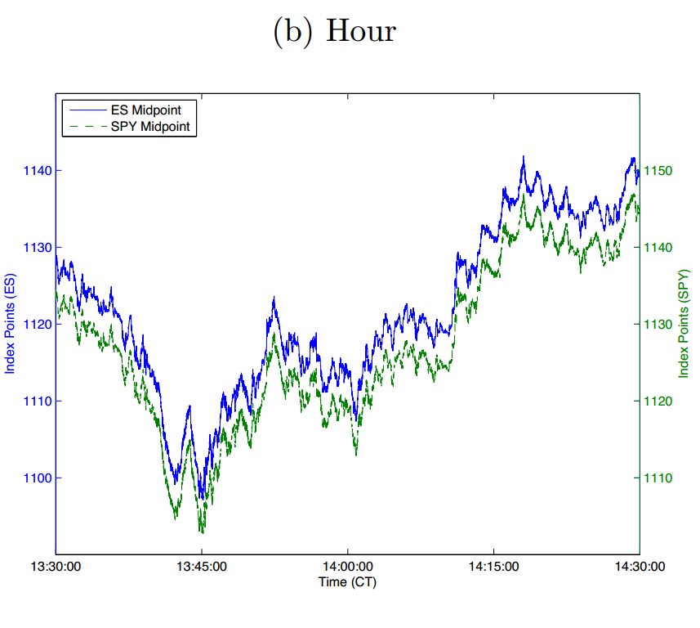
ES-SPY Trade
Source: Budish, Cramton and Shim (2013)

Slide 21
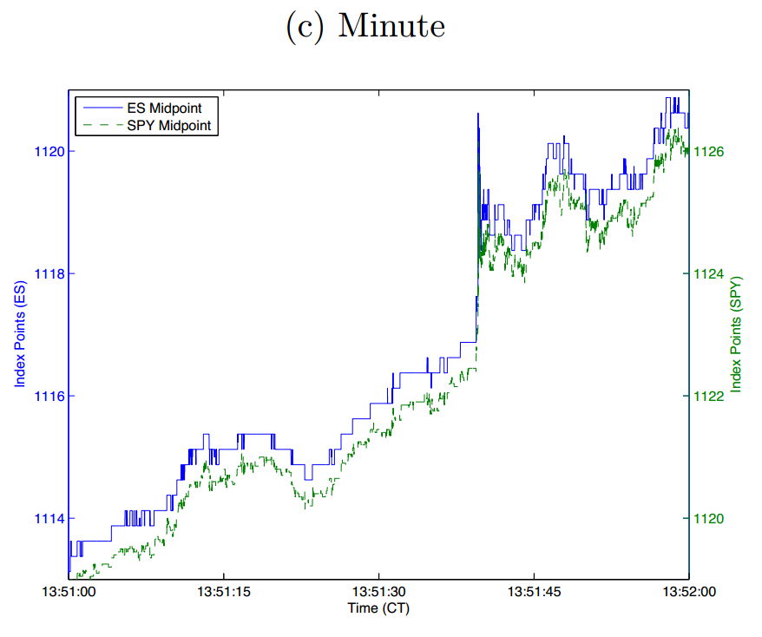
ES-SPY Trade
Source: Budish, Cramton and Shim (2013)

Slide 22
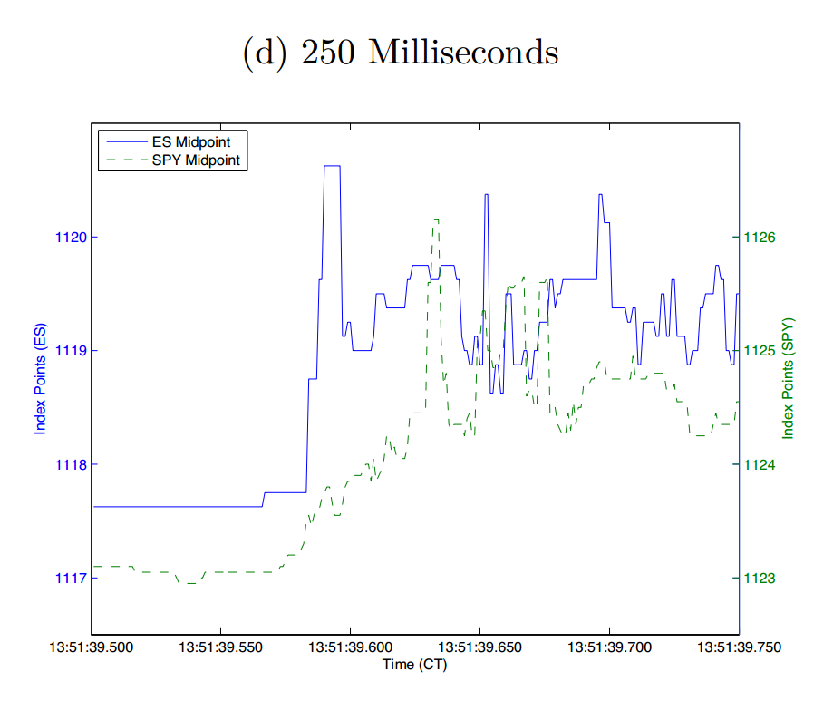
ES-SPY Trade
Source: Budish, Cramton and Shim (2013)

Slide 23
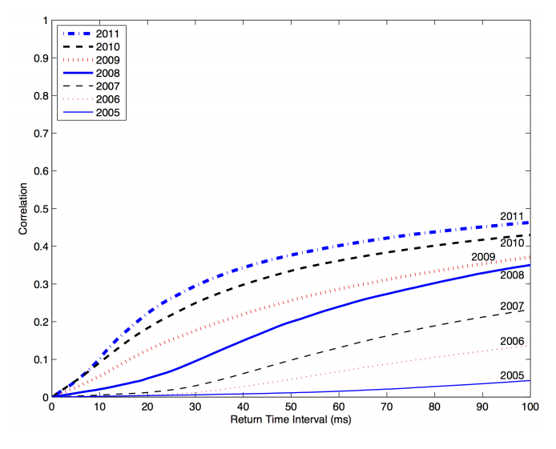
Correlations and Speed Race
Source: Budish, Cramton and Shim (2013)

Slide 24
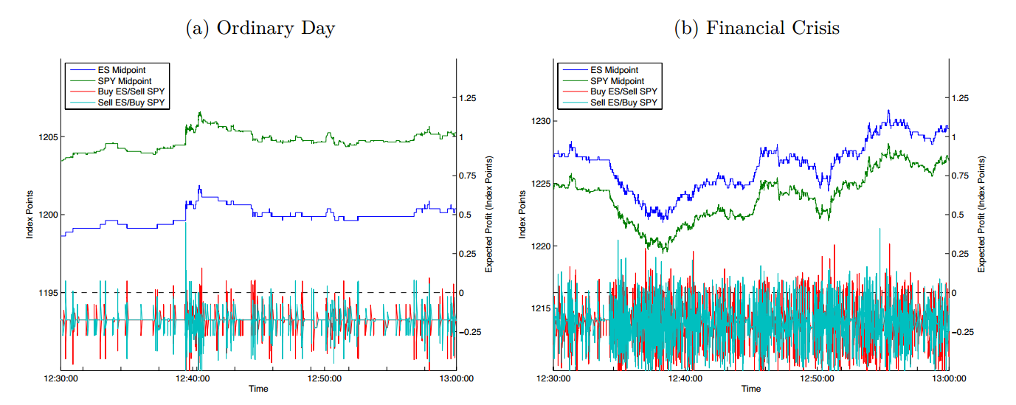
Arbitrage
Instantaneous profits from ES/SPY trade.
Source: Budish, Cramton and Shim (2013)

Slide 25
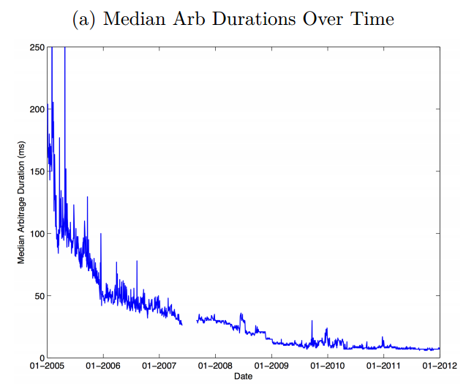
Arbitrage
Source: Budish, Cramton and Shim (2013)

Slide 26
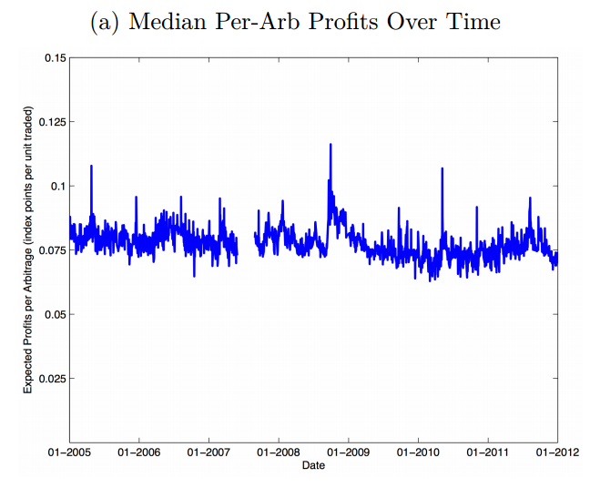
Arbitrage
Source: Budish, Cramton and Shim (2013)

Slide 27
Different Kinds of Arbitrage
Arbitrage between exchanges
  HP goes up on exchange 1, will go up on exchange 2.
Arbitrage between related securities
  HP goes up, then IBM also should go up.
Front-running large orders
  HP goes up => signals a big order => likely to go up more.
Front-running news
  Announcement of statistics or earnings => fastest trader exploits.
Many more strategies involving multiple securities, exchange fees and payments, etc…

Slide 28
Theory: Budish et al.
Budish, Cramton and Shim (2013) model.
Single security, trades on continuous order book.
Value of security is x.
  Jumps up to x+1 with probability k
  Jumps down to x-1 with probability k.
Regular investor shows up to buy/sell with probability z.
N high-frequency traders.
These traders compete to post bids/asks and then to trade when the value jumps up or down.

Slide 29
Theory
Suppose HFT firm posts an “ask” at price=p.
  With probability z, sells for p => revenue of p.
  With probability k, value decreases to x-1. Now, no one will buy at x => firm holds asset of value x-1.
  With probability k, value increases to x+1. What happens?
Triggers a race (assume HFT traders equal speed)
  Trader tries to withdraw her ask. Other traders try to buy.
  Withdraws with probability 1/N => holds asset of value x+1.
  Order gets “hit” with probability (N-1/N) => revenue of p.

Slide 30
Theory
Potential gain from regular trade
Potential loss from sniping
x-1
x
Ask p
x+1
HFT firm creating “liquidity” by posting an ask must trade off potential gain from regular trade, and potential loss from being picked off if value jumps up.

Slide 31
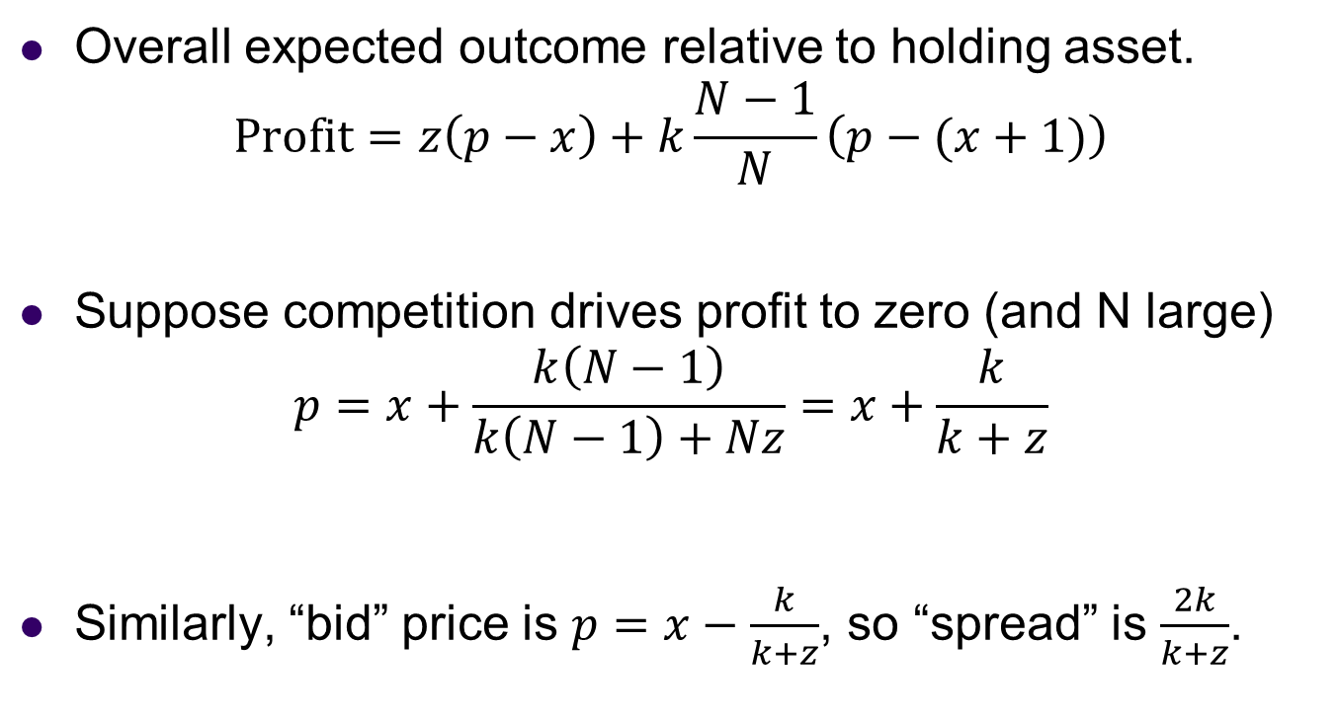
Theory
Overall expected outcome relative to holding asset.
$$\text{Profit}=z\left(p−x\right)+k\frac{N−1}{N}\left(p−(x+1)\right)$$
Suppose competition drives profit to zero (and N large)
$$p=x+\frac{k\left(N−1\right)}{k\left(N−1\right)+Nz}=x+\frac{k}{k+z}$$
Similarly, “bid” price is $p=x−\frac{k}{k+z}$, so “spread” is $\frac{2k}{k+z}$.

Slide 32
Competition and Spreads
What makes spreads larger or smaller?
  More opportunities for sniping => larger spreads
  More “market maker” competition => smaller spreads
Competition and spreads?
  If there was only a single trader who could post bids/asks, they could charge a monopoly price to potential buyers and sellers.
  Having traders compete to post bids and asks in the model means that “market makers” obtain zero profit.
  But further increases in HFT exacerbate stale quote sniping, and actually increase spreads – because competition is on speed rather than on price!

Slide 33
Market Design: Auctions?
Budish et al suggest solving the speed race by having a “batch auction” every 1 second, or 100 ms.
Why might this be a good idea?
  If value jumps up, firm posting ask can remove stale quote. So they can charge a smaller spread to begin with.
  If a regular “dumb” trader shows up and offers to buy, HFT firms will compete on price to fill the traders order.
What are the potential problems?

Slide 34
Innovations in exchanges
Competition between exchanges
  Exchanges compete to get orders routed their way.
  May pay traders to submit bids/asks (“pay for liquidity”) and charge traders to actually make trades. Or the reverse!
  Does it makes sense to have many exchanges or just one?
“Dark pools”
  Orders submitted to broker (e.g. Goldman Sachs) are “crossed” before being submitted publicly to the exchange.
  Traders cannot see what is going on in this “dark” exchange, which benefits from seeing the prices and being able to access the liquidity in the public exchanges.
Many interesting market design questions around the design of public and dark exchanges…

Slide 35
Summary
Financial exchanges compete to provide safe, liquid trading environment.
Organization of exchanges has evolved over time
  Call auctions to specialist/OTC markets to order books.
  Technology currently has led to faster, more fragmented trading, and some worry more systemic risk.
  Open questions around large trades, and in how public and dark exchanges fit together.
Economic theory helps us understand price formation & strategic trading, and benefits of competition in financial exchange.

